Slide 1
Smart energy meter and automation
Intelligent supervision of home appliances with energy consumption monitoring and energy saving mechanism using IoT with a mobile app interface to control and notify usage trends.

Slide 2
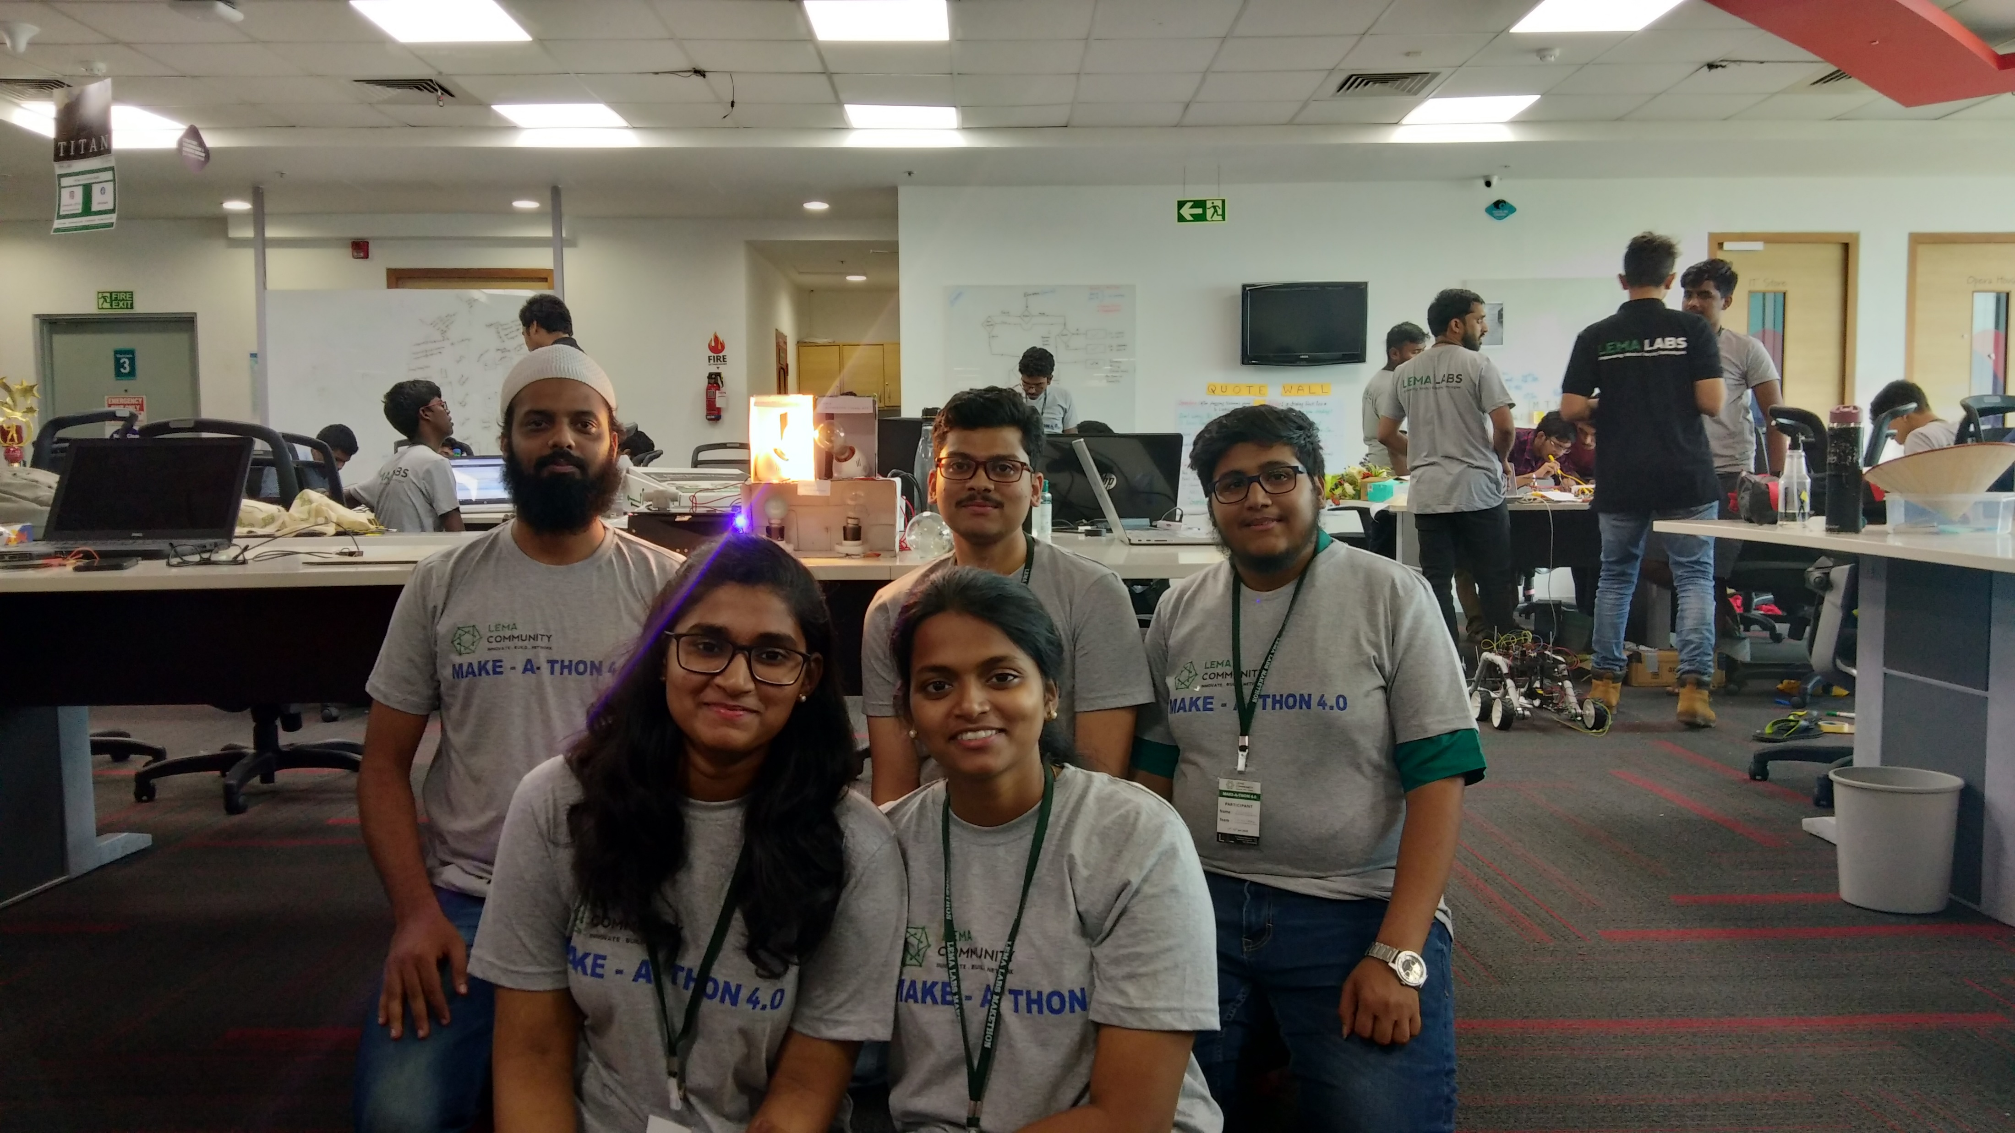
Team : ThingSenz
Rakshith N V
Chiranth K N
Elizabeth
Teressa
Imran Mohammed

Slide 3
OBJECTIVE:
To monitor the energy consumption by the domestic appliances.(Here we use 40, 60 and 100 Watts bulbs) via an application.
To automate the devices using the application.
To implement energy saving mechanism.

Slide 4
Features
Realtime energy analysis
IoT enabled
App interface
Threshold alerts
Bill payments
Energy saver- uses diming method via Pulse Width Modulation technique.
Data Security

Slide 5
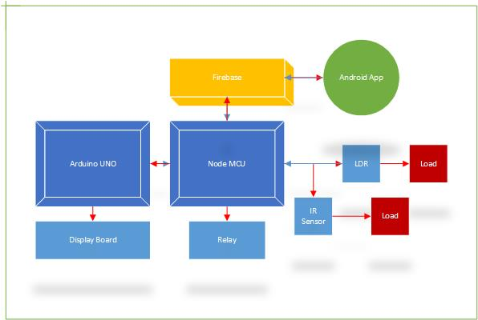
Block Diagram

Slide 6
Further Scope
Integrate ML algorithms to predict the kWh units of energy required ion a particular location.
Predicting Usage trends.
Integrate our present energy meter with water usage analysis and bill payments notifier.
Monitor home Temperature and gas detection.
Time based control and auto cut off of appliances.

Slide 7
Github repository link:
https://github.com/rakshithnv/makeathon_4.0

Slide 8
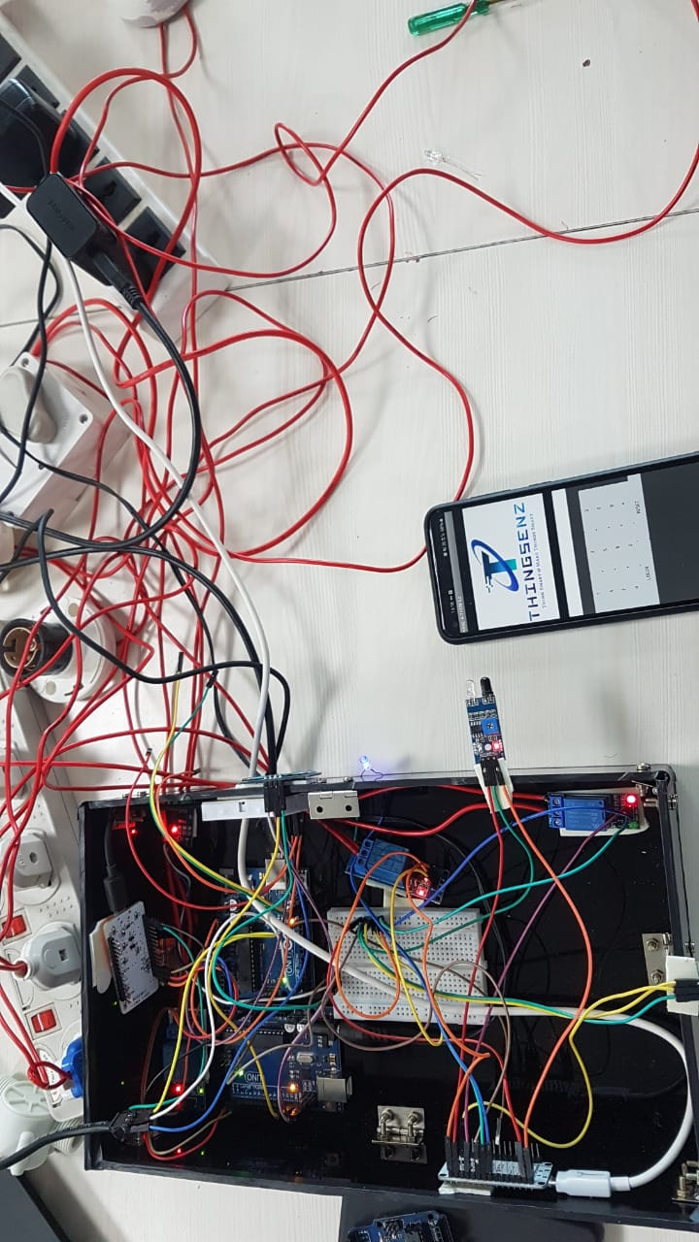
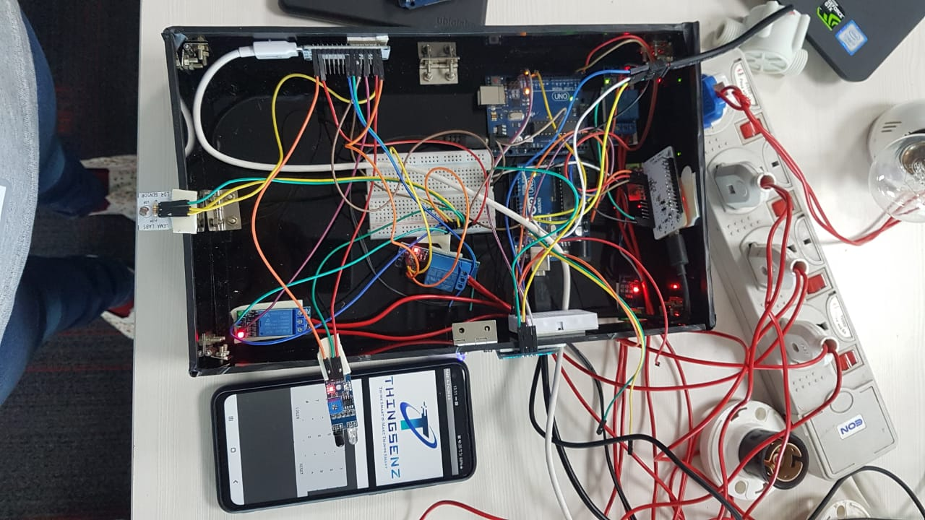
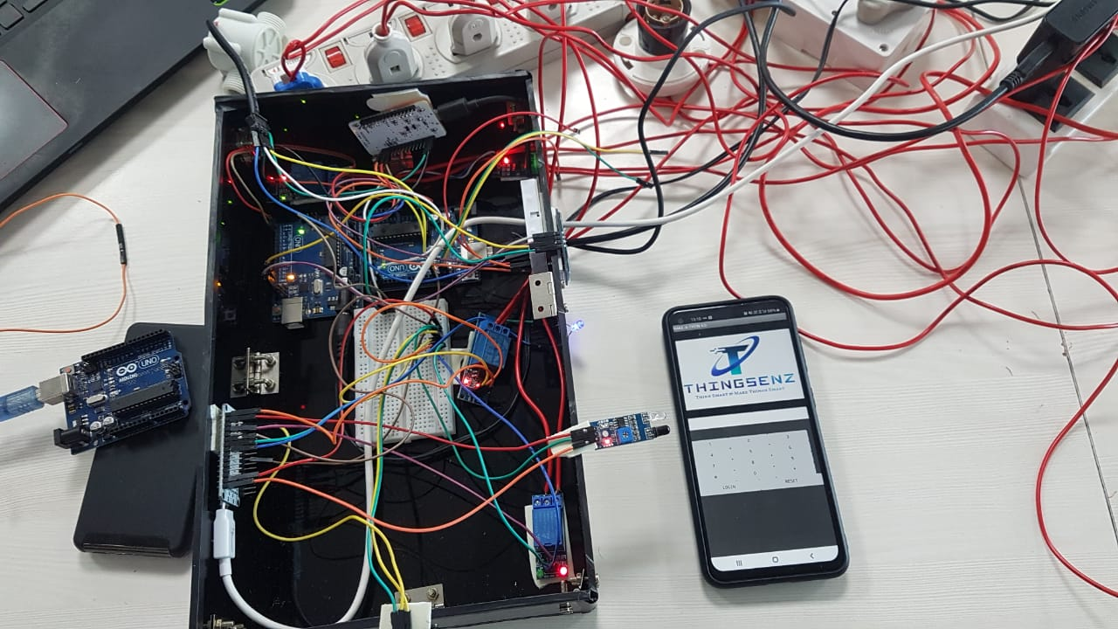
Prototype Snaps

Slide 9
THANK YOU

